Slide 1
FAST Application Overview - I
R. Sathiyamoorthi
Associate Team Lead
11-June-2012

Slide 2
Topics
Understand Salem Team members Knowledge on FAST Application
Frames in GUI Framework
FAST Screen Initial Load (without File Open)
TDS Screen
FHP Screen
Key Terminologies

Slide 3
Frames in the GUI Framework
MRU List
Top Frame for toolbar support
View frame (Actual Page) .
Left frame for Tree view support
The Main Application Frame
Status bar and framework buttons

Slide 4
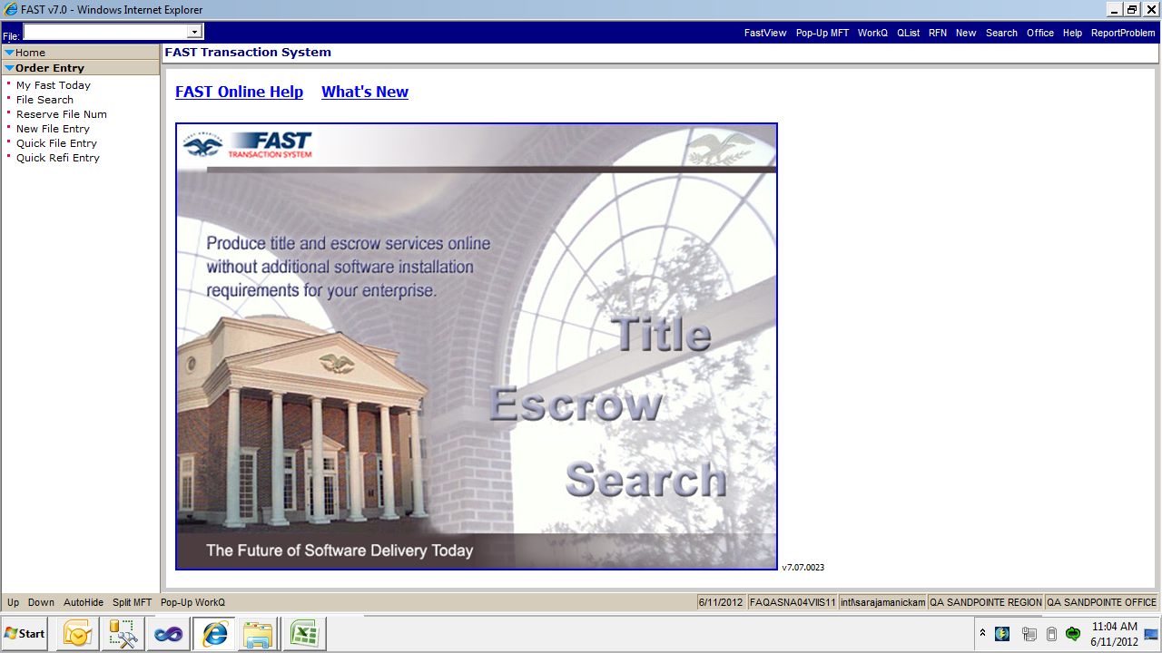
FAST Screen
File Number
Navigation Tree
Toolbar (Menu)
Fast Application Help
Application Version
System Date
Server Name
Logged in User Name
Logged In Region Name
Logged In Office Name

Slide 5
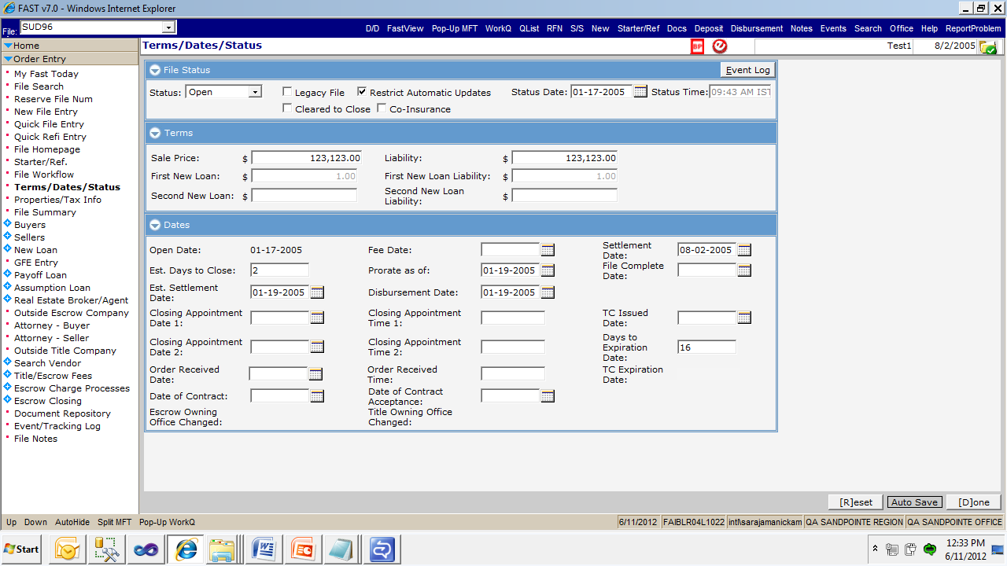
TDS Screen
Screen Name
Restrict Automatic Updates Icon
Settlement Date
File Status

Slide 6
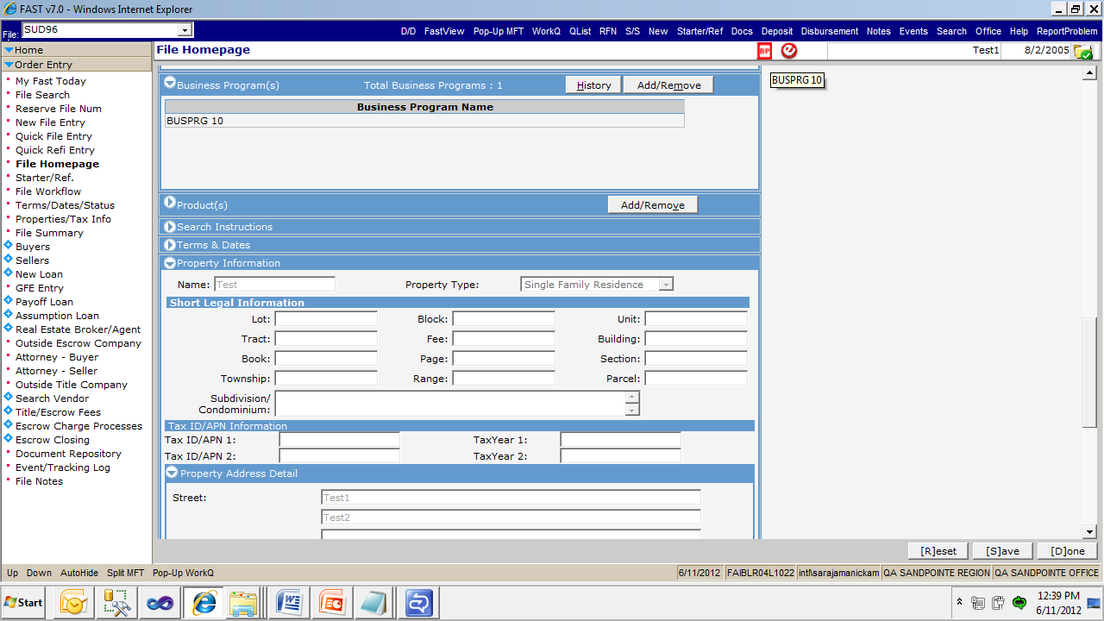
FHP screen
Business Programs Icon
Property Address

Slide 7
Key Terminologies
Corporation
Region
Office
Customer Order
Bus Org
FileBusinessParty
ServiceType
LoggedInRegion
LoggedInOffice

Slide 8
Key Terminologies
OwningRegion
OwningOffice
BusinessUnit
ServiceFile
TypeCDDmt
ClassType

Slide 9
CustomerOrder
Field Name | Purpose
OrderID | CustomerOrderID
SourceApplID | To Identify from Which interface File has created
OrderOriginatorID | To Identify whether the order is created through AgentFirst Or FASTWEB

Slide 10
ServiceFile
Field Name | Purpose
FileID | Primary key - Uniquely number across FAST
OrderID | CustomerOrderID
FileNum | FileNumber -Every region may have Duplicate File Number - User can create manual file number
BaseFileFlag | Whether the File is Master File Or Not
OwnerOfficeID | In Which Office file is created (File Owning Office ID)
ExternalFileNum | External File Number (FASTWeb, AgentFirst, myFirstam, LA.COM, Wintrack file number)
HUD_Flag | To identify whether the file is HUD file or Legacy file

Slide 11
BusinessUnit
BusinessUnitID | SuperBusinessUnitID | Name
1 | NULL | First American Corporation
2 | 1 | QA Sandpointe Region
3 | 2 | QA Sandpointe Office

Slide 12
ClassType
List of ClassTypes which are available in FAST application
TransactionType
PropertyType
BusinessSegment
ServiceType
ProductType
Corporation
Region
Office
etc

Slide 13
TypeCdDmt
To identify the group of values based on ClassTypeID
ClassTypeID = 1 will return list of transaction type
ClassTypeID = 2 will return list of Property Type
ClassTypeID = 3 will return list of Service Type
etc
Eg:
select * from TypeCdDmt where ClassTypeID = 1

Slide 14
Static Data Master Scripts
We have to declare newly introducing ClassType, TypeCdDmt, Activity, ActivityGrp, DocTypeDmt, Event, WorkflowEvent, Application, ServiceOperation, FormTemplate, WorkQuueTrigger in $/FAST/Static Data Master Script/Static Data Master Scripts.sql
Usage
Others will not use the same ID for their enhancement/defect fix.
To Avoid Build/Deployment Issue

Slide 15
Assignment
Create a file and check the data are getting saved in the relevant tables.

Slide 16
Thank You
sarajamanickam@firstam.com

